Slide 1
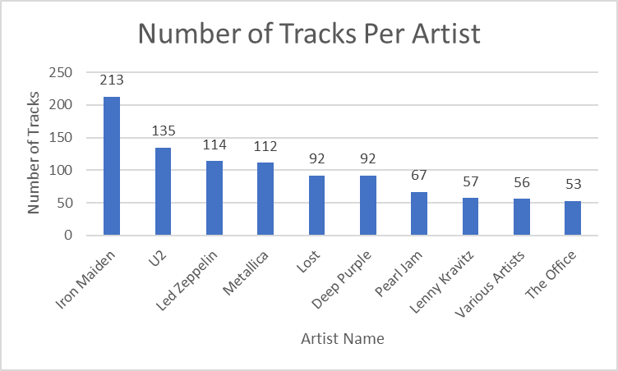
Who is the artist with the highest number of Tracks?
<visualization>
Iron Maiden is the artist who have the highest number of tracks with 213 tracks. He is by far higher than the second artist, (U2) who has 135 tracks.

Slide 2
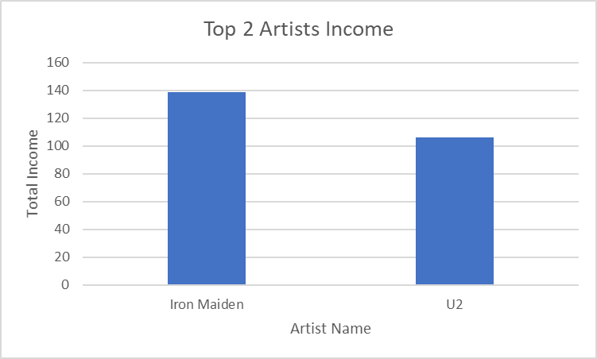
What is the difference between top 2 artists income?
<visualization>
In terms of Income, Iron Maiden has the highest Income (138.6). That is logical as he has the highet number of tracks.
The second top artist is U2, he has total income of (105.93).
The difference between 2 incomes is (32.6)

Slide 3
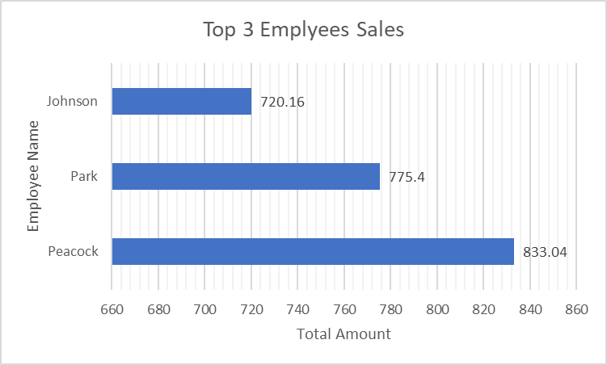
Who are the top 3 employees with the highest sales?
<visualization>
Peacock is the top emplyeee in sales with a total sales amount of (833.04). Park comes second with a total sales of (775.4). Finally, the third position is for Johnsons who achieved a ttal sales of (720.16)

Slide 4
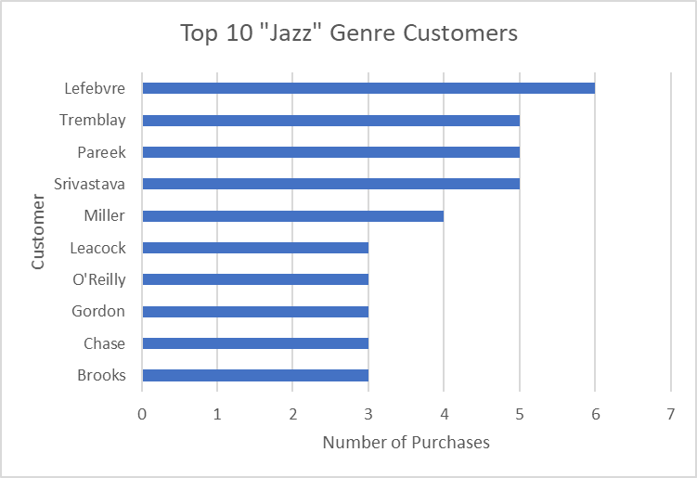
Who are the top 10 customers who purchased "JAZZ" Genre?
<visualization>
The bar graph shows the top 10 customers who purchased “Jazz” Genre. The top customer purchased it 6 times.
The top 10 customers made a total of 40 purchases for the same “Jazz” Genre

